Slide 1
Stock Simulation Game
Holly Atkinson, Micheal Kurdyla, Dominic Phillips, Kyle Singer, Fazeel Ur Rehman Abbasi, Yidi Wu
CISC/CMPE 320
November 22, 2019.

Slide 2
Project Description
Stock simulation game
Race against other users to maximize capital whilst not going bankrupt or getting bought out
Core functionality of the game will be a fast action, round based stock trading platform
Target audience is commerce students who want to participate in a stock trading experience without being exposed to the risks involved with real trading
Notes:
The player will observe a stock as its value climbs and falls. At some point, the player must decide when they want to sell their stock, aiming to make a profit before the value of the stock inevitibly plummets to being worthless.
The functional requirements of the game will describe what the game does. These features will be described through user stories in the format of "As a (stakeholder), I want to (goal) so that (motivation)".
As a user, I want to create a unique account so that I can track my wins.
As a user, I want a secure login system so that other players can't access my account.
As a developer, I want to create buy out functionality so that the win condition can be met.
As a developer, I want to create a graph so that the game is interactive and visually pleasing for the users.
As a user, I want the game to be based off of historical stock data so that I educating myself will hopefully lead to better results.

Slide 3
Demonstration
**include screenshot of GUI here**
Exit to demonstration??
Notes:
Game Layout:
Login in with unique username credentials.
Join the lobby with other players until game is ready to start.
Game initializes & simulation begins. At the beginning of the game, each user is given the same amount of initial capital which can be used before each round to purchase shares in the current stock.
During each round the user will be able to liquidate their stock at any point in time with the goal of pulling out before the round crashes while maximizing their growth.
During and in between rounds the players will have the ability buy out other players which leads to the win condition of the game (last man standing).
Upon game completion, winner will have their win count updated in the .json file.

Slide 4
Team Techniques
”Special Purpose Team” technique used
Divide larger team into hyper-focused smaller teams
Front-end, back-end, game functionality
Successes
Weekly updates on sub-team progress
Clearly identifying issues week by week and adding to sprints
Work guided by flow chart
Splitting up tasks within sub-teams to avoid merge errors
Challenges
More communication between sub-teams beyond weekly meetings
Lack of game outline at beginning of project lead to confusion and game malleability throughout semester

Slide 5
Work Distribution
Front-End Sub-Team
Created dynamic graph that can be interacted with
Multi-page GUI showing different components of project
User can interact with interface while the changes are stored
Back-End Sub-Team
Server hosted on Linux
Clients hosted Windows systems
Entire server-client relationship built on sockets
Multithreading used for asynchronous sending/receiving for both clients and server
Game Functionality Sub-Team
Develop model to mimic stock market for players to interact with
Create Stock Generator class to output a graph of the simulation for players to interact with
Develop game logic
Logic of how players interact with the interface
Logic of how players interact with each other
Notes:
The playability of the game will be the primary focus during development. We will have playtesting sessions in order to ensure that the game is fun and working as intended (in addition to other tests). The game has multiple parameters that can be changed to make sure that it meets our desires.
Game mechanics:
Stock simulation based on historical data
Players benefit from being knowledgeable in stock theory
Player decides when they want to sell their stock, they are in control
Randomization added to make the game nondeterministic
Stock description helps users estimate the performance of the stock
Buy-out interactivity between users
Players who are performing well are rewarded
Last man standing declared as winner
Increases competitive aspect of the game
Lobby includes chat between all participants
Teamwork to collaborate to take down big threats
Lobby includes active player list
Know who else is in your lobby
Adjust your playstyle knowing the competence of your opponents
Login functionality
Users get profiles where they can view their performance in previous games

Slide 6
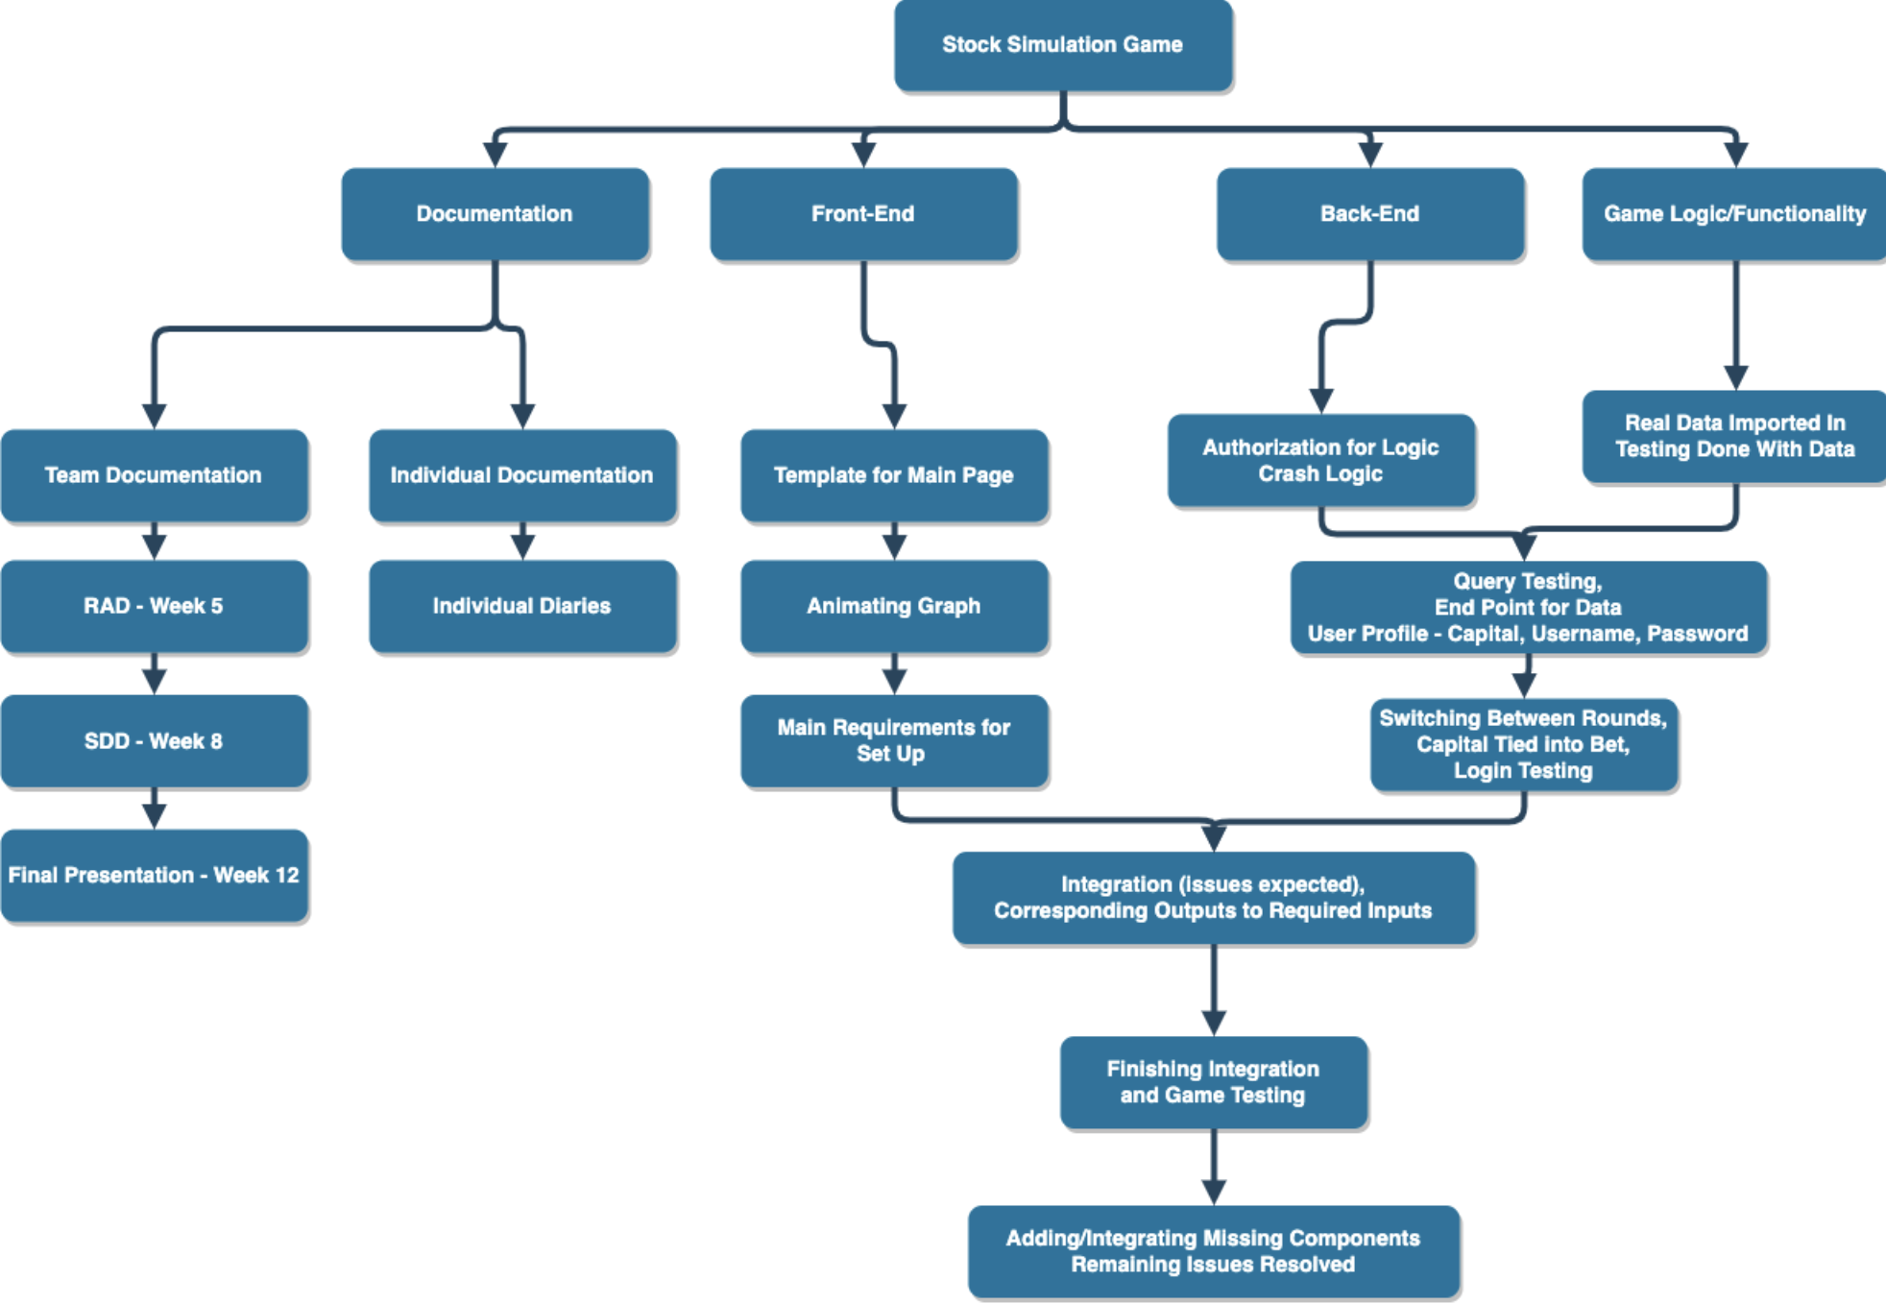
Work Distribution
Work distribution chart developed at the beginning of semester
Final completion of sub-team code integration in Weeks 11 & 12

Slide 7
Challenges Overcome
Front-End Sub-Team
Real-time graphing data
Learning Qt
Many Qt only aspects to understand
Back-End Sub-Team
He
lo
Game Functionality Sub-Team
Lack of clear outline around game logic
Developing model for stock simulation
Fine tuning stock simulation algorithm to return realistic results

Slide 8
Active Difficulties
Front-End Sub-Team
Creating a working chat box for users to interact during the simulation
Back-End Sub-Team
He
lo
Game Functionality Sub-Team
Lack of clear outline around game logic
Developing model for stock simulation
Fine tuning stock simulation algorithm to return realistic results

Slide 9
Library Usage
Qt library usage
Good libraries visually, but do not exist on many IDE’s
Led to many team members needing to download Qt Creator IDE in order to run the program
IDE does not show errors well – difficulty debugging

Slide 10
Work in Progress
Front-End Sub-Team
Back-end integration
Button functionality integration with game logic
Back-End Sub-Team
He
lo
Game Functionality Sub-Team
Solidify game security
Implement new game logic for additional features
Buy out functionality
Log out functionality
Winning conditions
Per round fee

Slide 11
Improvements for Future Projects
Creation of Game Logic Flowchart at beginning of semester
Use alternate IDE for front-end due to Qt library issue
Improved team wide communication
Improved communication with TA

Slide 12
Questions?

Slide 13
Thank you!

